Slide 1


Stakeholder Analysis
Chapter 1: Introduction & Initialization
Universität St.Gallen
08.04.2024
Berner Fachhochschule
Biel

Slide 2
Content Chapter 1
Introduction
Initialization and Preparation
Context Analysis

Slide 3
Supply Chain Viability and the Goal of the Stakeholder Analysis
Introduction
In the past, supply chain management mainly focused on efficiency and cost savings. However, recent events such as the COVID-19 pandemic, the war in Ukraine, the Taiwan conflict, and the climate crisis have highlighted the importance of resilience and sustainability alongside efficiency for companies.
To meet future challenges, companies must consider all three dimensions: efficiency, resilience, and sustainability. We call this concept "Supply Chain Viability." By optimizing these three aspects equally, companies can better navigate future challenges and move away from solely prioritizing profit and exploiting nature.
Viability represents not only a theoretical approach but also a path toward a new economy where we can meet the needs of various stakeholders.
The Stakeholder Profiler helps companies identify relevant stakeholders along their supply chain and understand their efficiency, resilience, and sustainability requirements. Companies can prioritize actions and develop future-proof “viable” supply chain strategies by knowing stakeholder demands.

Slide 4
Structure of the Stakeholder Analysis
Introduction
  Chapter 1:
  Initialization
  Chapter 2:
  Stakeholder Identification
  Chapter 3:
  Requirements Identification
  Chapter 4:
  Strategy Development
  Initialization & Preparation
  Team Set-up
  Definition of Objectives
  Information Gathering
  Context Analysis:
  Scope Definition
  Supply Chain Performance
  Supply Chain Mapping
  Stakeholder Identification
  Brainstorming the Stakeholders
  Crosscheck with Stakeholder Map
  Stakeholder Prioritization
  Important Stakeholders
  Power Interest Matrix
  Identification of Existing Knowledge
  Introduction to Stakeholder Requirements
  Key Insights from Research
  Data Gathering
  Evaluation & Prioritization
  Development of a Roadmap
  Development of a Viable Supply Chain
  Identification of Synergies between Efficiency, Resilience & Sustainability

Slide 5
Content Chapter 1
Introduction
Initialization and Preparation
Team-Setup
Definition of Objectives
Information Gathering
Context Analysis

Slide 6

Task: Form an Interdisciplinary Team
Team-Setup
Form an interdisciplinary team with different key roles. Typical functions:
  Supply chain management, logistics, sourcing and procurement, quality management, marketing, finance, environmental, sustainability, IT, sales/customer support, production, and business performance.
  Bring in roles from different age groups and levels of experience.
  A chief Supply Chain Officer may be found in larger organizations; in smaller corporations, product managers could be responsible for SCM.
Initiate a Kick-Off meeting where you introduce the project and ensure everyone is informed about the basics of supply chain viability.
You can save your notes in our template “Team-Setup”.

Slide 7
Content Chapter 1
Introduction
Initialization and Preparation
Team-Setup
Definition of Objectives
Information Gathering
Context Analysis

Slide 8
Task: Define a Goal for the Stakeholder Analysis
Definition of Objectives
The Stakeholder Analysis helps you:
  Identify key stakeholders shaping your supply chain decisions
  Understand their needs and expectations regarding your supply chain
  Gain a comprehensive view of your supply chain environment from various stakeholder perspectives
Ultimately, it enables the focal company to:
  Establish a sustainable supply chain in the long run
  Enhance awareness of future supply chain trends
  Improve stakeholder satisfaction
  Identify risks and opportunities across the supply chain
Determine a realistic time frame for the implementation:
  For the short version, you will need approximately 1-2 month
  For the extensive version, you will need approximately three month
Feel free to use our "Goals" template to document your objectives. We suggest to discuss the objectives in a short workshop with your core team.

Slide 9
Content Chapter 1
Introduction
Initialization and Preparation
Team-Setup
Definition of Objectives
Information Gathering
Context Analysis

Slide 10
Task: Identify Existing Stakeholder-Knowledge within your Company
Information Gathering
Consolidate all available information about your stakeholders from internal and external sources within your company.
This process aids in forming an initial understanding of your stakeholder landscape.
Leverage synergies by assigning each team member to gather pertinent information from their specific area of expertise.
Check the hints on internal and external data sources on the next slides.

Slide 11
Internal Data Sources
Information Gathering
Internal company documentation and reports:
  Where to find: Company intranet, departmental folders, project management tools, organizational charts.
  What to look for: Previous stakeholder analyses, project reports, annual reports, meeting minutes documenting stakeholder interactions.
CRM (Customer Relationship Management) systems:
  Where to find: Sales and marketing departments.
  What to look for: Contact details, communication history, customer feedback, contract details, contract registers that can give an indication of customer and partner requirements and expectations.
ERP systems (Enterprise Resource Planning):
  Where to find: Logistics, purchasing, production and finance departments.
  What to look for: Information on suppliers, logistics partners, cost structures that provide insights into the supply chain and potential efficiency or sustainability requirements.

Slide 12
External Data Sources
Information Gathering
Industry reports and market studies:
  Where to find them: Online databases such as Statista, industry associations, and consulting companies.
  What to look for: Trends, challenges, and best practices in the industry that can highlight stakeholder requirements.
Trade journals and publications:
  Where to find: Libraries and online portals for specific trade journals.
  Articles and studies that provide insights into new developments, regulatory changes, and industry standards.
Social media and forums:
  Where to find: LinkedIn, industry forums, Twitter.
  What to look for: Discussions, comments, and posts by and about stakeholders that reflect their opinions, concerns, and requirements.
Legal and regulatory publications:
  Where to find: Official government and regulatory agency websites.
  What to look for: Laws, standards, and guidelines that could impact your stakeholders and impose requirements on your products or processes.

Slide 13
Content Chapter 1
Introduction
Initialization and Preparation
Context Analysis
Scope Definition
Evaluating the Supply Chain Performance
Supply Chain Mapping
Evaluating the Existing Technological Landscape

Slide 14
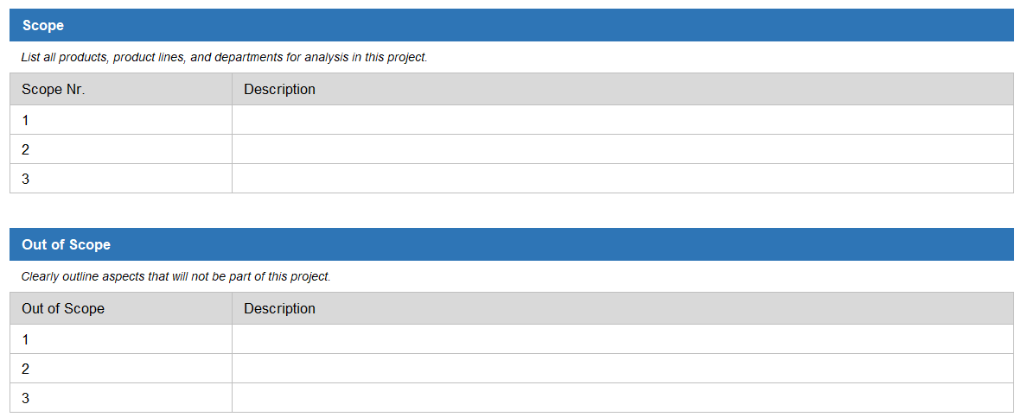
Task: Define the Bounderies for the Stakeholder Analyzation
Scope Definition
Define the scope of the analysis by specifying which areas, product lines, or departments of your company are included.
Typically, SMEs consider their entire organization, but it could also be limited to specific parts.
Feel free to use our "Scope" template to document your results.

Slide 15
Content Chapter 1
Introduction
Initialization and Preparation
Context Analysis
Scope Definition
Evaluating the Supply Chain Performance
Supply Chain Mapping
Evaluating the Existing Technological Landscape

Slide 16
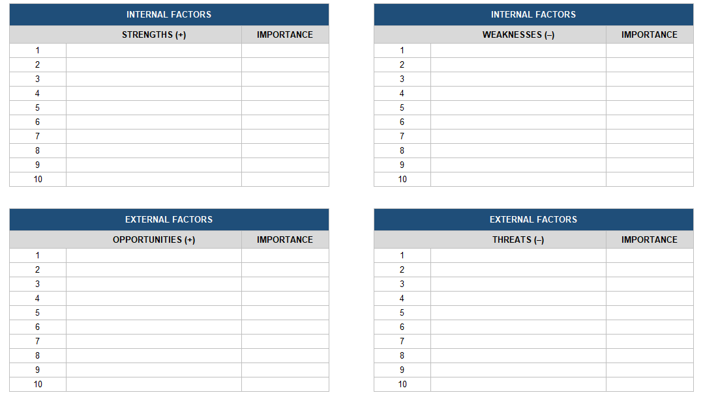
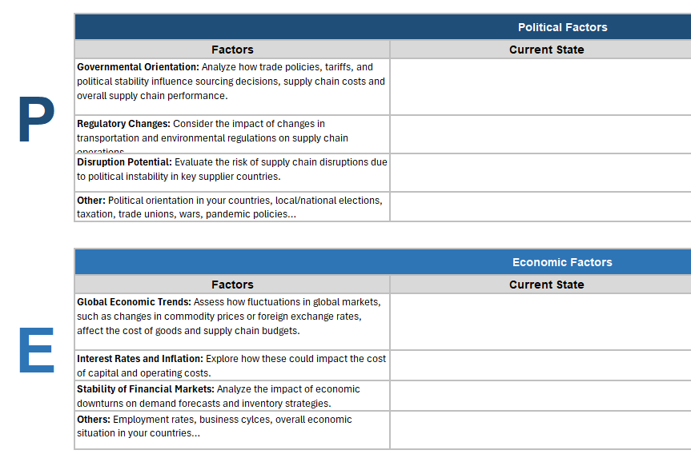
Task: Conduct a PESTEL- and SWOT-Analysis
Evaluating the Supply Chain Performance
We suggest developing both frameworks with your team.
For both frameworks, you could describe two perspectives:
  The current state (Status Quo)
  The possible future state (what has to be expected)
Summarise the results and identify the most important findings.
Feel free to use our templates «PESTEL» and «SWOT»

Slide 17
PESTEL Framework
Evaluating the Supply Chain Performance
  The PESTEL analysis helps to understand the macroeconomic environment in which your supply chain operates. It considers political, economic, social, technological, environmental and legal factors.
Evaluate how political changes, trade agreements, or tariffs could affect your supply chain.
Check the impact of legal requirements and laws relevant to your supply chain.
  Political
Analyze economic trends such as exchange rate fluctuations, inflation, or growth that may affect costs and availability.
  Legal
  Economic
Consider environmental aspects such as sustainability standards or carbon footprint.
  PESTEL
Investigate demographic changes, consumer trends, or social movements that could influence demand.
  Environ-mental
  Social
Assess the impact of new technologies on your supply chain efficiency and innovation.
  Techno-logical

Slide 18
SWOT-Analysis
Evaluating the Supply Chain Performance
  The SWOT analysis focuses on the internal strengths and weaknesses of your supply chain as well as on external opportunities and threats.
  Internal
  External
S W O T
  Strengths
  Identify what makes your supply chain particularly good, e.g. strong relationships with reliable suppliers.
  Weaknesses
  Identify areas where your supply chain can be improved, e.g. bottlenecks or inefficient processes.
  Opportunities
  Look for external opportunities to improve your supply chain, e.g. through new technologies or markets.
  Threats
  Evaluate external risks for your supply chain, such as political uncertainties or natural disasters.

Slide 19
Content Chapter 1
Introduction
Initialization and Preparation
Context Analysis
Scope Definition
Evaluating the Supply Chain Performance
Supply Chain Mapping
Evaluating the Existing Technological Landscape

Slide 20
Task: Develop a Supply Chain Map
Supply Chain Mapping
Generate a supply chain map with your team based on the specified scope, setting clear boundaries for the map.
Look at the introduction to supply chain mapping and related techniques on the following slides for guidance.
Decide how detailed you want the map to be. We suggest keeping it simple by focusing on the most essential parts of your supply chain network.
The supply chain map will make it easier to discuss stakeholders later.

Slide 21
Mapping as the Basis for Increasing Viability
Supply Chain Mapping
Supply chain mapping documents a supply network's relationships and material flows. This enables companies to identify and evaluate strategic information such as problem areas and risks. The supply chain map serves as a basis for the targeted development of supply chains and provides a comprehensive "big picture.”
A useful supply chain map should cover three main aspects:
  Companies and suppliers involved, including your own company
  Technologies used in the supply chain
  Capabilities that influence the operational conditions of the supply chain (e.g., just-in-time).
Supply chain mapping is not the same as a detailed process map, although it can be descriptive of the current or prescriptive of a possible future state of the supply chain. Standardized symbols are crucial in both cases.
Creating a detailed supply chain map requires resources and time. We recommend that you first create an initial draft and then work continuously on improving and deepening the map. The transparency achieved through the supply chain map is fundamental for efficiency, resilience, and sustainability and supports the development of future-proof supply chain strategies – the main objective of this profiler.

Slide 22
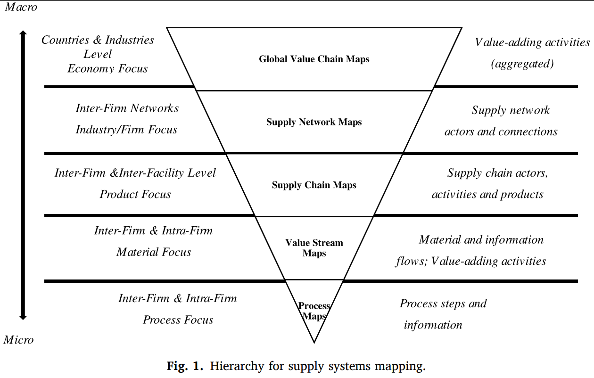
The Variety of Mapping Levels
Supply Chain Mapping

Slide 23
Geometrical Attributes of Supply Chain Maps
Supply Chain Mapping
Attributes | Description
Tiers | The "tiers" in the supply chain represent different levels of suppliers, starting with the raw material suppliers (tier n) through to the manufacturer of the end product (tier 1). This hierarchy illustrates the complexity of the supply chain and shows the degree of traceability.
Direction | It shows the supply chain's flow of materials, products, and information. Arrows or lines visualize this flow and allow the traceability of raw materials to the end customer.
Level of aggregation | Specifies the level of detail with which the supply chain is displayed. A high level of aggregation means that the map only shows the main actors and flows. In contrast, a low level of aggregation contains detailed information about each stakeholder and each process step.
Geographical location | Shows the physical locations of all stakeholders and production sites, including countries and cities.

Slide 24
Perspective Attributes of the Supply Chain Map
Supply Chain Mapping
Attributes | Description
Focal point | Determines the main focus or interest of the map by focussing on the company, the industry, a market or the customer.
Scope: Product width | Determines the scope of the products or product lines shown in the map, varying from individual lines to comprehensive portfolios, depending on the objectives and the defined scope.
Scope: Depth of the mapped processes | Describes the representation of important processes in the supply chain on the map, from raw material procurement to production, distribution and customer service.
Scope: Cycle time | Includes the various cycles within the supply chain that are depicted on the map (e.g. return channels and feedback loops).

Slide 25
Functional Attributes of the Supply Chain Map
Supply Chain Mapping
Attributes | Description
Material and information flow | Shows how materials, products and information flow through the supply chain. This can be visualised using arrows that represent the transport of goods and data.
Critical junctions and bottlenecks | Areas within the supply chain that are particularly susceptible to disruptions or bottlenecks. Can be highlighted using special symbols or colours.
Risk levels | The assessment of the risk levels of different parts of the supply chain based on factors such as political stability, natural disasters or supply reliability. Risk levels can be mapped using a colour-coded scale (e.g. green for low, yellow for medium, red for high).
Capacities and services | Depict the production or delivery capacities of the stakeholders and how efficiently they operate. Can be represented by bar charts or figures next to the respective elements (e.g. KPIs).
Compliance and certifications | Information on stakeholder compliance with industry standards, certifications or sustainability practices. Can be represented by specific icons or badges.
Transport routes and modes | The different transport routes and modes used to move products, including road, rail, air and sea. Can be represented by differently designed or colored lines or icons.

Slide 26
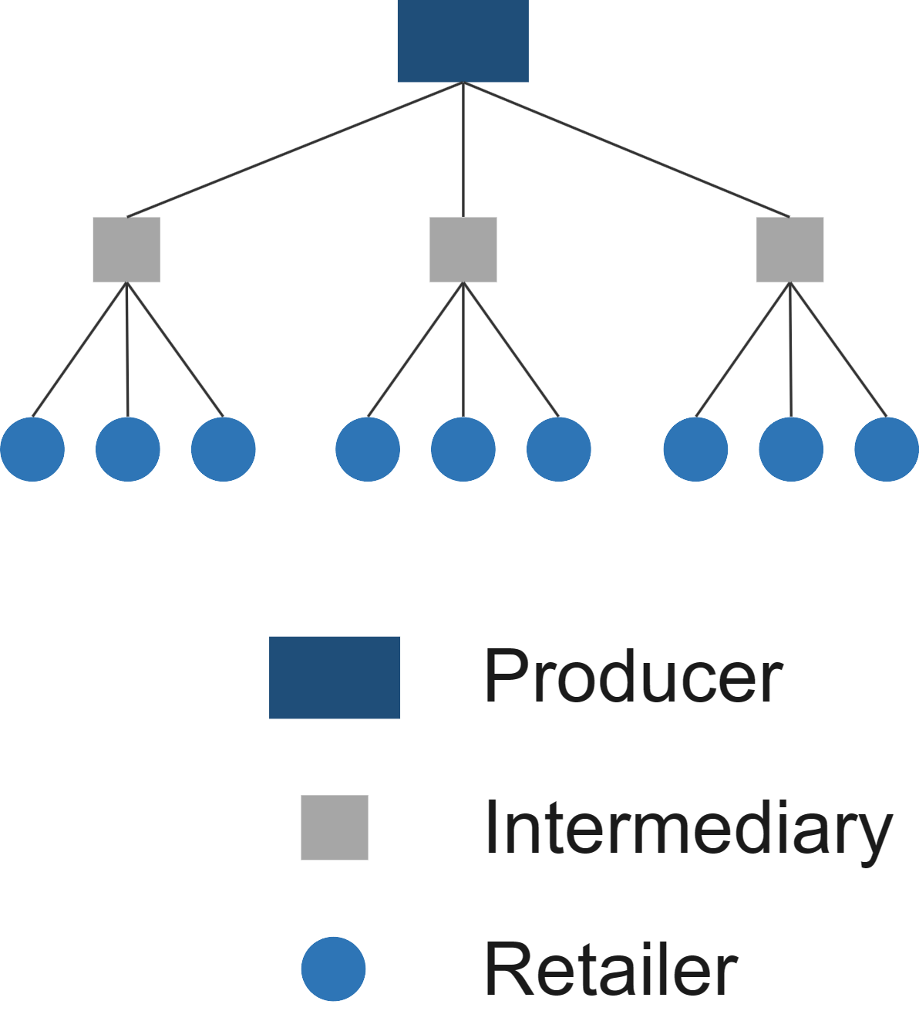
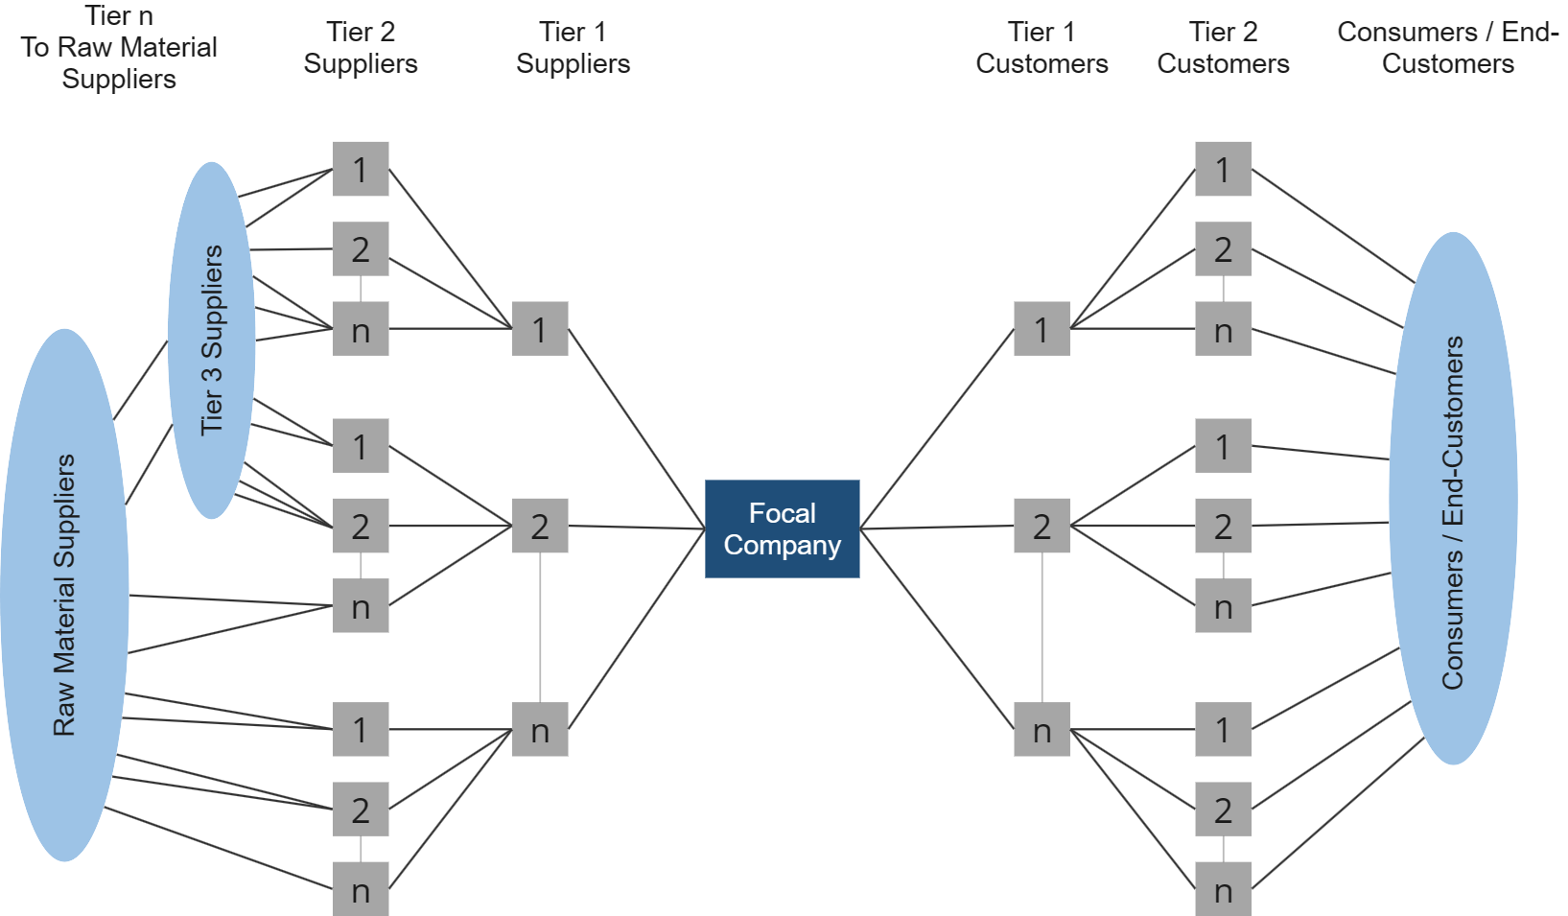
Different Supply Chain Map Examples
Supply Chain Mapping
Goods and Information Distribution Hierarchy
Supply Chain Network Structure

Slide 27
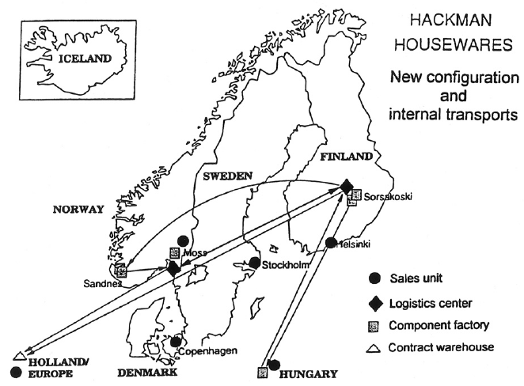
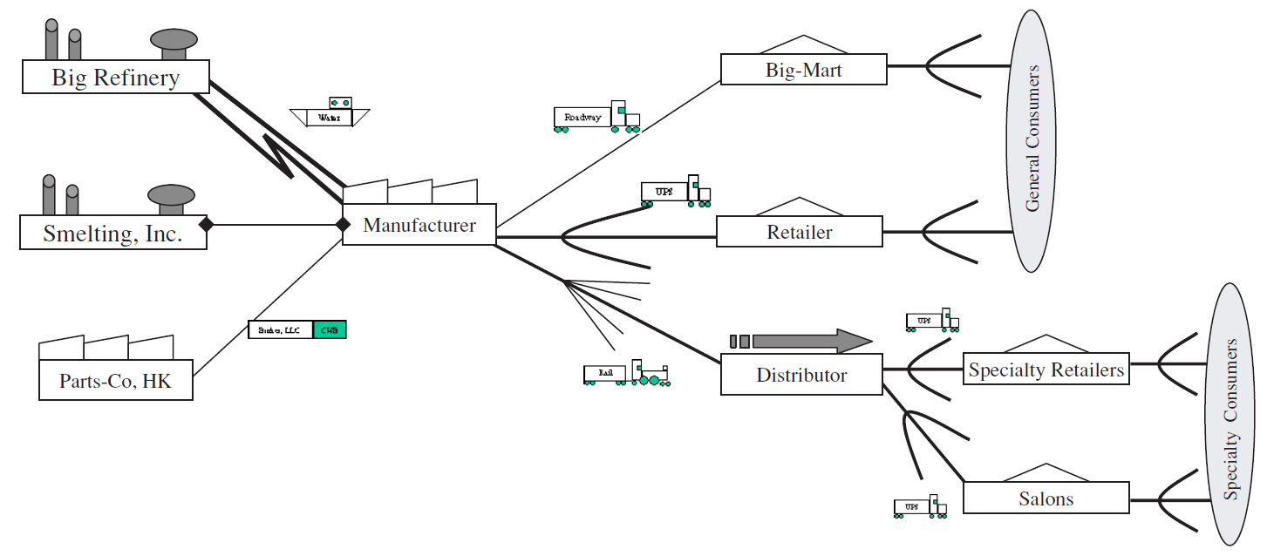
Different Supply Chain Map Examples
Supply Chain Mapping
Geographical Representation
Sample Map for a typical SME
Gardner and Cooper (2003), Figure 7
Gardner and Cooper (2003), Figure 16

Slide 28
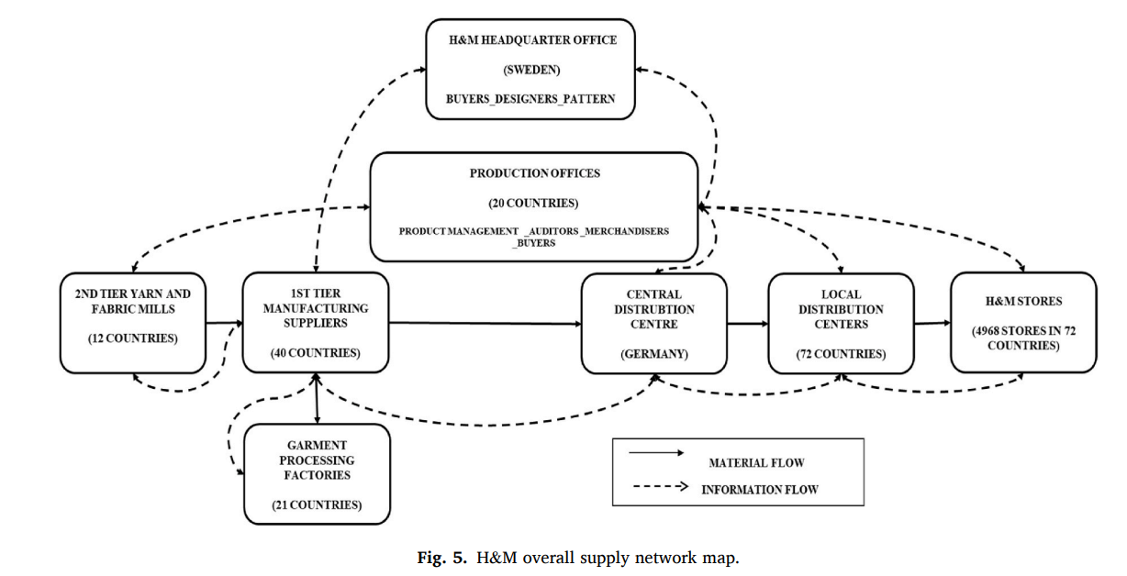
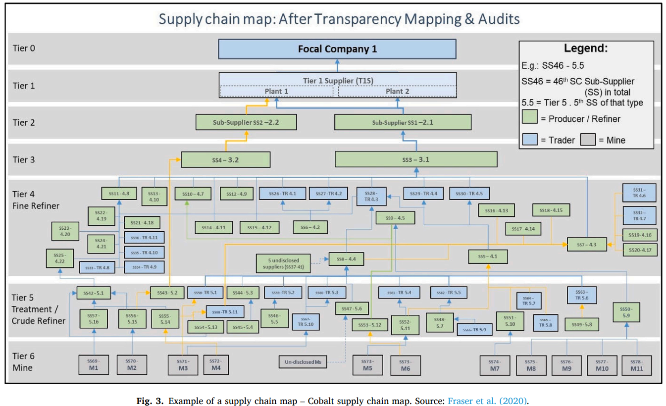
Different Supply Chain Map Examples
Supply Chain Mapping
Over Supply Network Map
Example of a Cobalt Supply Chain Map
Fraser et al. (2020), Figure 5
Fraser et al. (2020), Figure 3

Slide 29
Data Sources for Supply Chain Mapping
Supply Chain Mapping
Primary data is collected through interviews, direct observations, company documents and internal systems such as ERP systems. Collecting primary data is resource intensive and often requires the support of senior management. Nevertheless, it provides the best insights into aspects such as lead time, performance and potential risks. In many SMEs, however, it is difficult to collect this data comprehensively due to a lack of time and resources. In addition, suppliers are often reluctant to provide data for fear of competitive disadvantage.
Secondary data is used at higher hierarchical levels and is available through national and international organizations. Try to identify publicly available data sources that are relevant to your industry, such as Harmonized Systems HS or International Standard Industrial Classification (ISIC). Data from chambers of commerce or trade organizations may also be of interest.
It is recommended to start with secondary data sources at macro and micro level and then gradually add more information through primary data sources. It is important to update the map regularly as supply chains are dynamic.

Slide 30
Possible Tools and Software Support
Supply Chain Mapping
The choice of a suitable tool depends on your plans. If your company already has software tools, you can use them. Virtually any tool that visualizes processes and relationships can be used for a simple supply chain map.
Common tools such as PowerPoint or Microsoft Visio are ideal for pragmatic solutions. They are easy to use and offer standardized templates. Another tool is MIRO, which is also available in a free version. For companies with programming skills, general programming languages such as R or Python with iGraph, Neo4j and NetworkX can also be used.
There are also a variety of commercial solutions that combine data sources with publicly available data to create detailed maps. Some well-known solutions are Sourcemap, Achilles and Resilinc. For a focus on risk analysis, there are tools such as RiskMethods. Common supply chain planning solutions such as Blue Yonder or Coupa also offer mapping functions if your company has them.

Slide 31
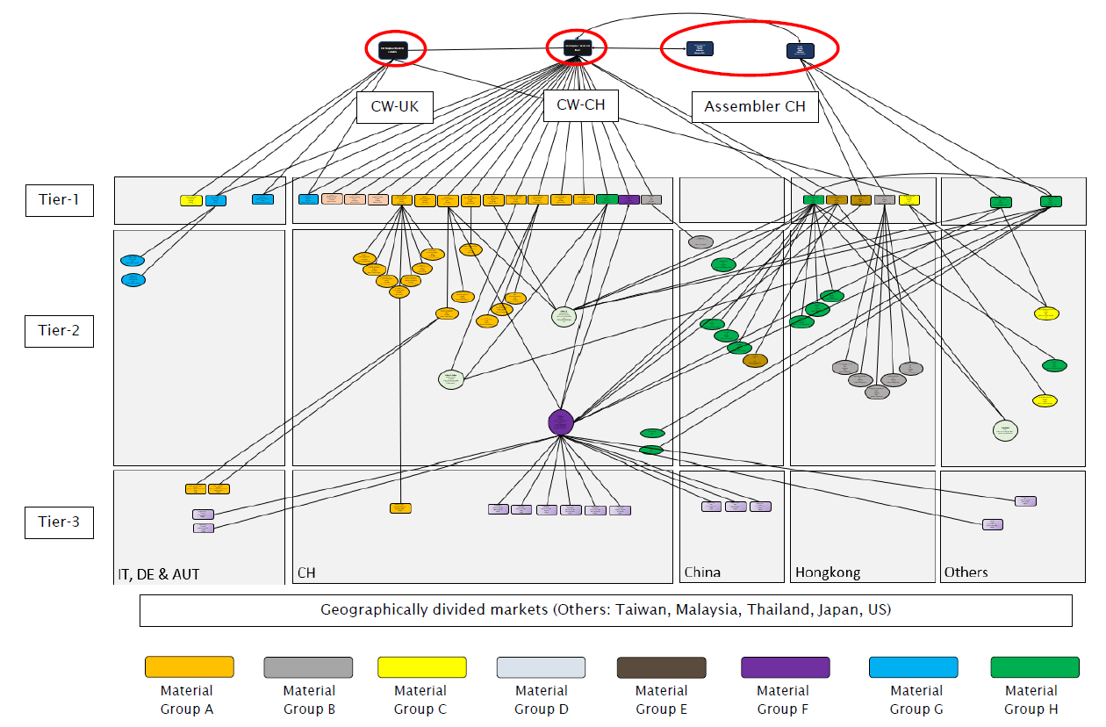
Simple Supply Chain Map Example: Swiss Case Study for Upstream Suppliers
Supply Chain Mapping

Slide 32
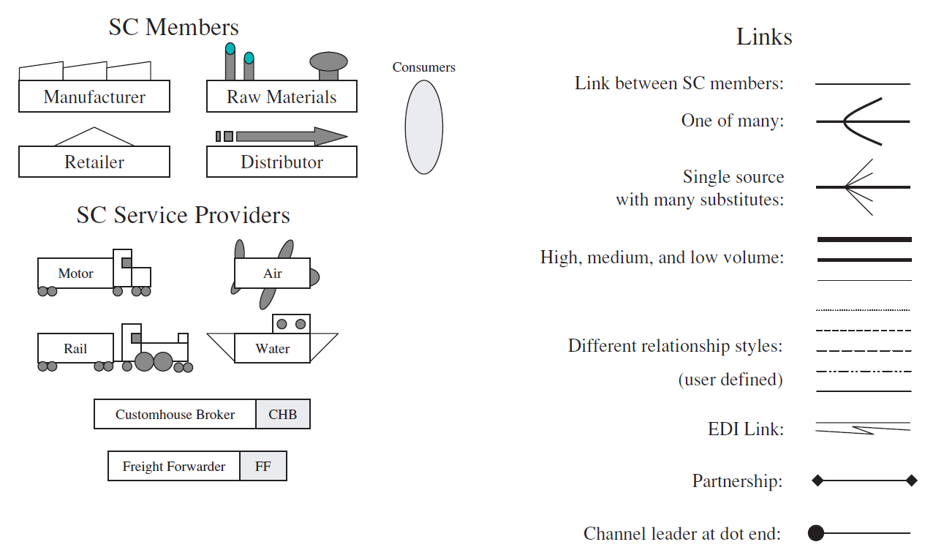
Possible Mapping Conventions
Supply Chain Mapping
Important nodes can be emphasized by the size of their symbols, with larger symbols indicating larger companies or higher market shares.
Wider connecting lines can be used to emphasize the importance of transactions or information between nodes.
Network structures such as network communities can be represented by using different colors or symbols for membership in the community.

Slide 33
Stakeholder Analysis
Chapter 2: Stakeholder Identification
Universität St.Gallen
08.04.2024
Berner Fachhochschule
Biel

Slide 34
Content Chapter 2
Stakeholder Identification
Stakeholder Prioritization

Slide 35
Task: Identify Stakeholders in your Supply Chain
Stakeholder Identification
Schedule a workshop with your team to brainstorm and list all potential stakeholders that could impact your supply chain.
During the session, document each stakeholder and consider their primary interests in terms of efficiency, resilience, or sustainability, along with their level of influence on your supply chain.
Refer to the framework provided on the next slide to help guide the discussion.
To organize your findings, utilize the "Stakeholder Identification" template from our toolkit, which includes two different layouts (Stakeholder Register 1 and Register 2).

Slide 36
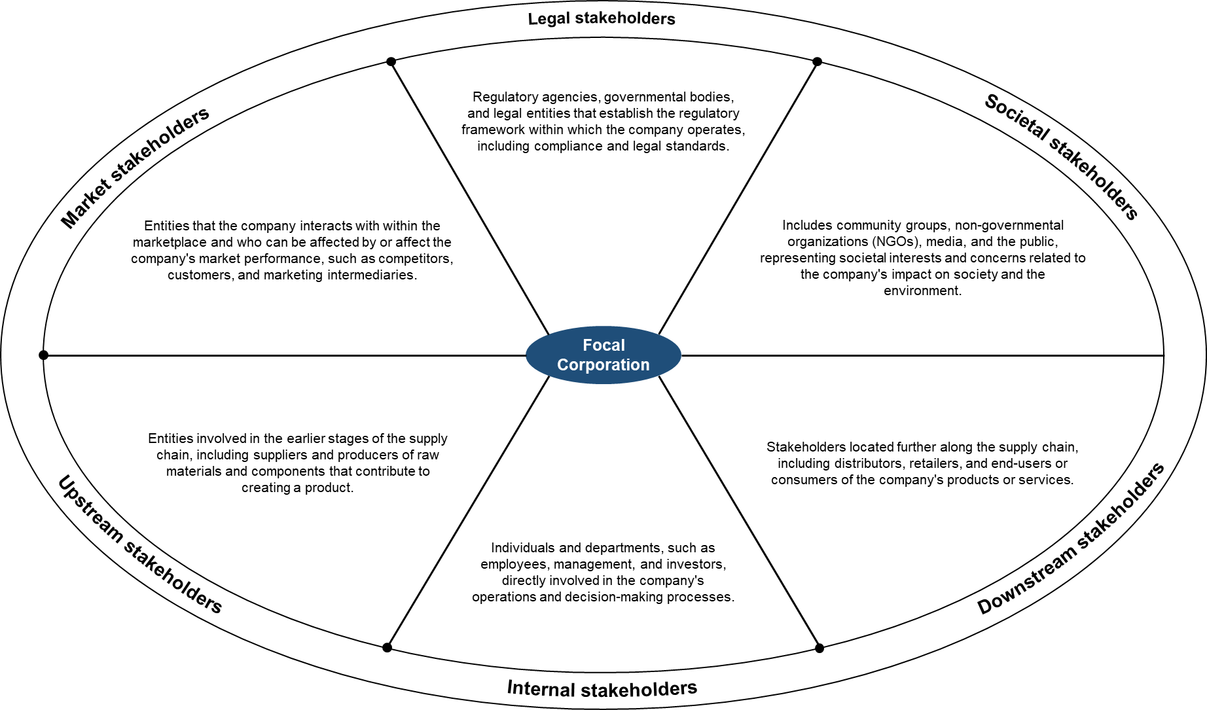
Guidance for Stakeholder Brainstorming
Stakeholder Identification

Slide 37
Task: Crosscheck with Stakeholder Map
Stakeholder Identification
After listing your stakeholders, compare it with the stakeholder map on the next slide. Each class includes different general stakeholders.
Discuss with your team whether additional stakeholders might affect your supply chain.
Use the PESTEL and SWOT analyses you have already done to identify relevant stakeholders in different categories.
You will likely need to conduct additional research to gather more detailed information about the following stakeholders for your specific use case:
  Customer organizations linked to your product/service
  Industry/market associations
  Think-tanks and research groups within your industry/market
  Environmental regulators in the countries where you operate
  Safety and health groups and unions in the countries where you operate
  Key NGOs relevant to your activities

Slide 38
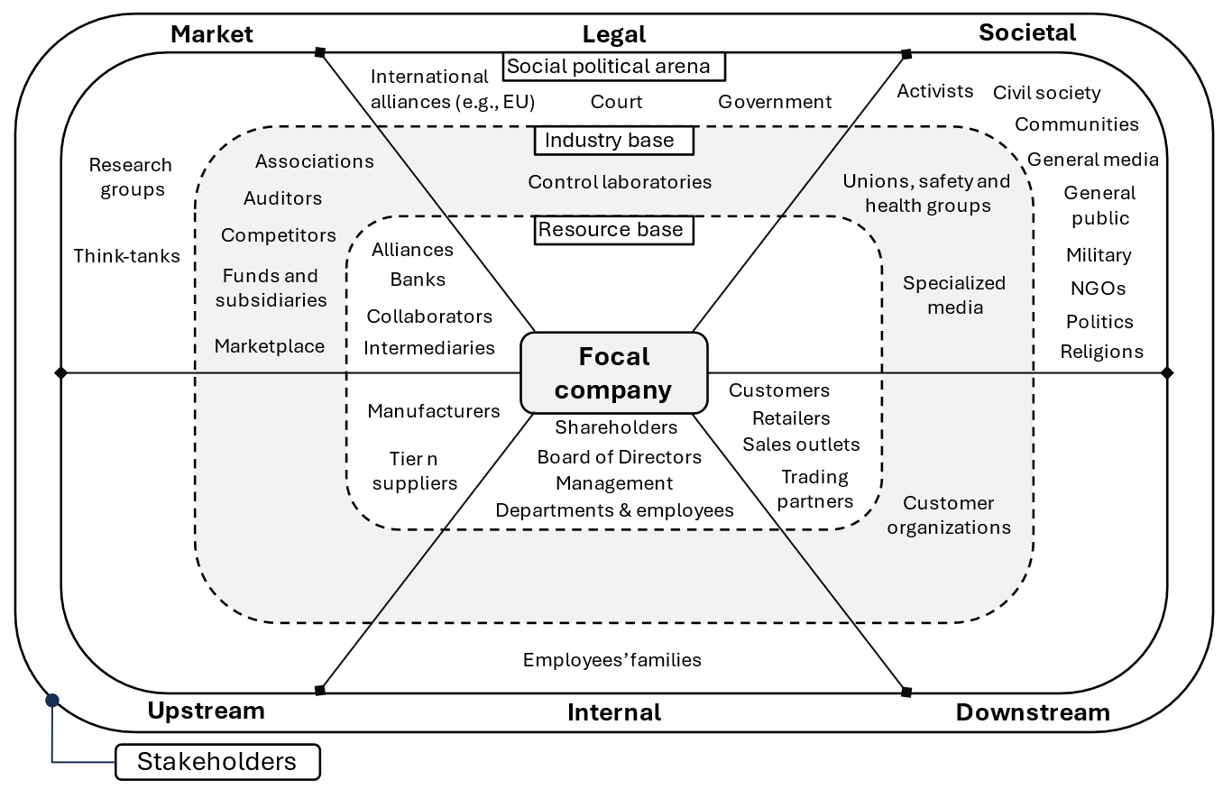
Stakeholder Map for Crosscheck
Stakeholder Identification

Slide 39
Content Chapter 2
Stakeholder Identification
Stakeholder Prioritization

Slide 40
Task: Evaluate the Interest & Power of each Stakeholder
Stakeholder Filtering
Assess each identified stakeholder by considering the following factors:
  Their interest in efficiency, resilience, or sustainability.
  The level of their interest (high, medium, or low).
  Their influence or power on your company and supply chain, including their ability to impact decisions or activities.
Refer to our research results on the next slide for guidance but remember that stakeholder prioritization may differ based on your use case.
Utilize our Stakeholder Register template for this prioritization process.
Main interest of each stakeholder. They may have multiple columns since they could be interested in all three dimensions.
Stakeholder's interest level in the chosen dimension.
Stakeholder's influence on your organization.

Slide 41
Interest vs. Power Matrix
Stakeholder Prioritization
High priority to identify requirements
Very high priority to identify requirements
Internal
stakeholders
Internal
stakeholders
Internal
stakeholders
High
Legal
stakeholders
Downstream
stakeholders
Downstream
stakeholders
Power
Upstream
stakeholders
Legal
stakeholders
Societal
stakeholders
Market
stakeholders
Market
stakeholders
Market
stakeholders
Downstream
stakeholders
Upstream
stakeholders
Efficiency
Low
Legal
stakeholders
Upstream
stakeholders
Resilience
Societal
stakeholders
Socetial
stakeholders
Lower priority to identify requirements
High priority to identify requirements
Sustainability
Low
Interest
High

Slide 42
Key Findings from our Project on Stakeholder Prioritization
Stakeholder Prioritization
Market Stakeholders, such as competitors, are crucial as they stimulate business activity.
The environment and community are closely linked to upstream stakeholders.
The focal company receives many requirements from downstream stakeholders, i.e., customers, and transfers them to upstream stakeholders. These upstream stakeholders must align with these requirements and be considered in the requirements analysis.
Tier-1 suppliers act as catalysts for further developments upward by enforcing their company's requirements. Understanding their needs well promotes collaboration.
While shareholders and investors are considered separately, they often have similar requirements.
The customer always takes precedence as value creation stems from them.
Civil society dictates when/how deliveries occur. Their immediate power over companies is low but can influence them in the long term.

Slide 43
Task: Identify Your Key Stakeholders
Stakeholder Prioritization
Decide which stakeholders are important enough to collect detailed requirements in the next phase.
Review your list of stakeholders and evaluate if each is significant for gathering specific efficiency, resilience, and sustainability requirements.
You can utilize our template in the stakeholder register for this evaluation.
On the subsequent slides, we suggest a minimal set of relevant stakeholders where gathering more detailed requirements would be beneficial. Based on these recommendations, you can guide your team's discussions.
The stakeholder’s final importance to your organization.

Slide 44
Minimal Stakeholder Priority Recommendations
Stakeholder Prioritization
Based on our research, we suggest prioritizing at least the following stakeholders for further investigation of their specific requirements regarding efficiency, resilience, and sustainability in the next chapter:
Market stakeholders
  Marketplace and the respective industry expectations
  Industry associations
  Main competitors in the market
Legal stakeholders
  Laws and regulations
  Government (incl. governmental agencies)
  Safety and health groups in your industry
  If applicable: Financial institutions related to your use case
Societal stakeholders
  NGOs related to your use case
  Civil society / opinion within your use case
  Activist groups and surrounding communities
Upstream stakeholders
  Tier 1 suppliers
Focal stakeholders
  Shareholders and investors
  Board of directors and top management
Downstream stakeholders
  End customers
  Customer organizations

Slide 45
Stakeholder Analysis
Chapter 3: Requirements Identification
Universität St.Gallen
08.04.2024
Berner Fachhochschule
Biel

Slide 46
Content Chapter 3
Identification of Existing Knowledge
Introduction to Stakeholder Requirements
Key Insights Research
Data Gathering
Evaluation and Prioritization

Slide 47
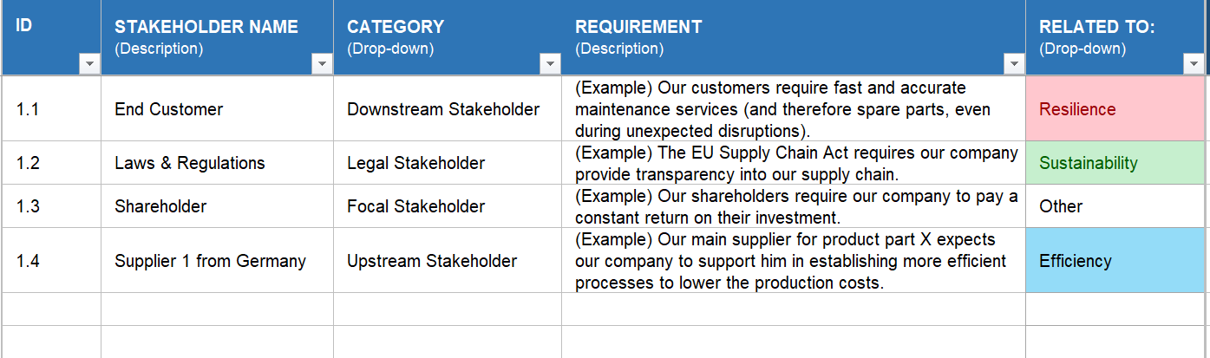
Task: Identify Existing Knowledge about Stakeholder Requirements
Identification of Existing Knowledge
Return to chapter 1 and review the stakeholder information you have identified.
Document all identified requirements in the "REQs-FROM-Stakeholders" template within the database, noting the respective sources.
Prioritization will occur later; for now, focus solely on listing the identified requirements.
For each requirement, specify its relation to “Efficiency”, “Resilience”, “Sustainability”, or mark it as applicable to “All of Them” or “Other”.
…
…
…
…
…
…
…
…
…
…

Slide 48
Content Chapter 3
Identification of Existing Knowledge
Introduction to Stakeholder Requirements
Key Insights Research
Data Gathering
Evaluation and Prioritization

Slide 49
Task: Explore General Stakeholder Requirements
Introduction into Stakeholder Requirements
Discover common stakeholder requirements for efficiency, resilience, and sustainability in the supply chain on the following slides.
These findings are based on our research project and will serve as a foundation for identifying specific stakeholder requirements.
Later, we will suggest methods for gathering detailed data and prioritizing these requirements.

Slide 50
Introduction into the Standard Requirements
Introduction into Stakeholder Requirements
Through literature research within the Innosuisse project, our project has identified various stakeholder requirements for the focal company and vice versa (see method on next slide).
These requirements provide a high-level direction for companies and stakeholders. In the following chapters, it is the goal that you will dive deeper into your stakeholders' specific requirements and contact them to identify their concrete requirements.
The upcoming slides prioritize these requirements into three categories:
Must-have: These requirements are essential for the company's survival and non-compliance poses existential threats, such as violating fundamental laws.
Important: Fulfilling these requirements brings significant benefits to the company, but non-compliance can have severe consequences, such as demands from key customers or suppliers.
Nice-to-have: The remaining requirements are not critical for the company, though implementing them could enhance its image. Their non-fulfillment does not lead to serious consequences.

Slide 51
Requirements flow between the Focal Company and Stakeholders
Introduction into Stakeholder Requirements
In most cases, stakeholders communicate their requirements to the focal corporation. For instance, customers may demand sustainably manufactured products, prompting the company to meet these requirements.
Stakeholders
Focal Corporation
Conversely, the focal company may also impose demands on its stakeholders. For instance, to meet end customers' sustainability requirements, the company may require specific standards from its suppliers. The strategies derived from this profiler will determine the requirements the focal company imposes on its stakeholders.

Slide 52
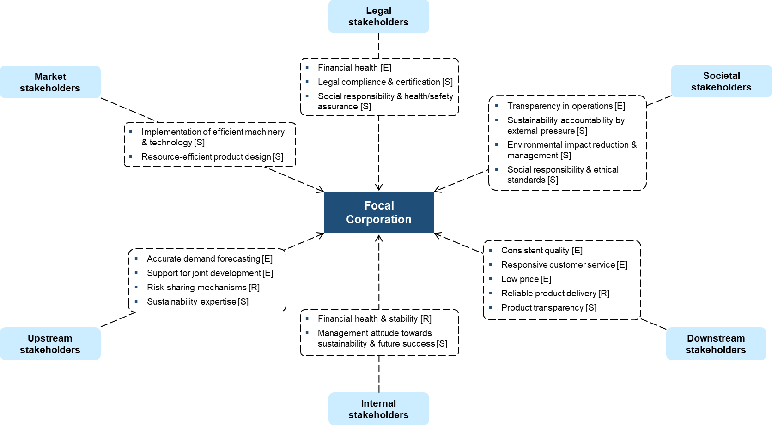
The Requirements Map shows higher-level Stakeholder Requirements for the Focal Company
Introduction into Stakeholder Requirements

Slide 53
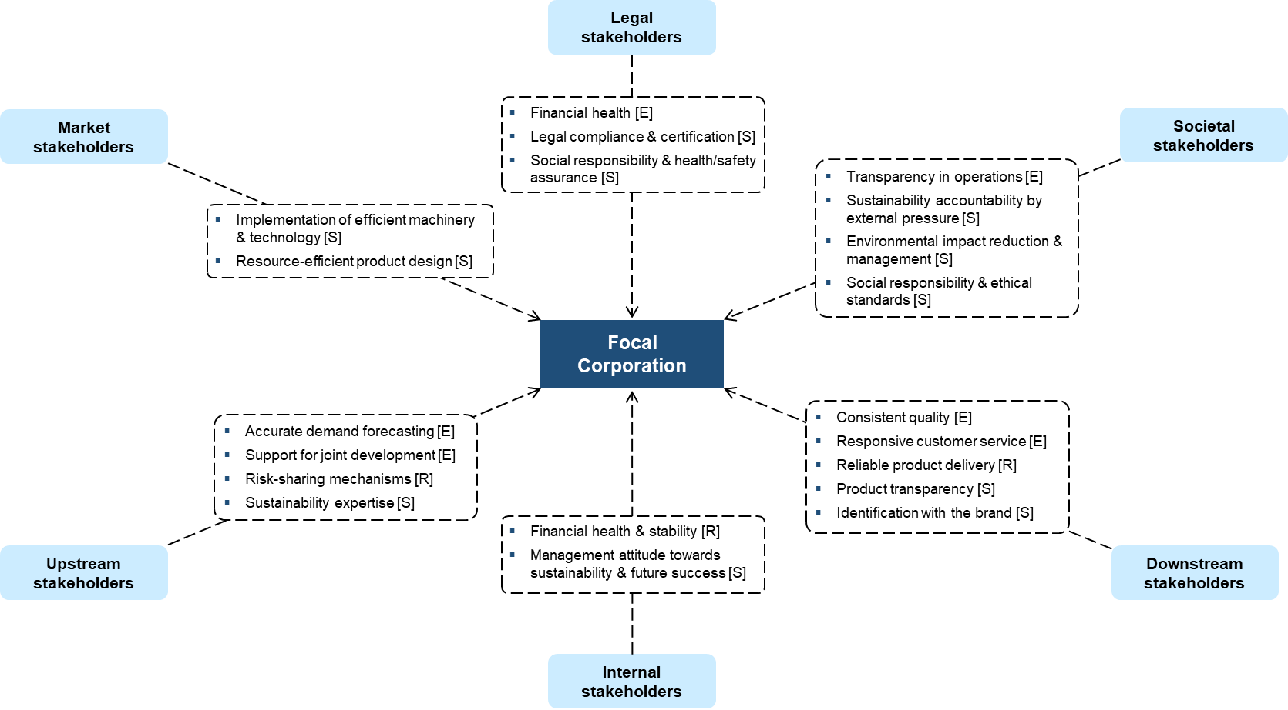
The Requirements of Upstream Stakeholders for the Focal Company
Introduction into Stakeholder Requirements
Efficiency Requirements [E]
Resilience Requirements [R]
Accurate demand forecasting: The focal company provides accurate, predictable, and constant demand forecasts to the upstream suppliers.
Support for joint development: The focal company supports joint development efforts and resource transfers with the upstream stakeholders.
Risk-sharing mechanisms: The focal company provides risk-sharing mechanisms and payment security even in disruptive times.
Sustainability Requirements [S]
Sustainability expertise: The focal company is assisting upstream stakeholders with sustainability expertise.

Slide 54
The Requirements of Internal Stakeholders for the Focal Company
Introduction into Stakeholder Requirements
Efficiency Requirements [E]
Resilience Requirements [R]
Financial health, stability, and efficiency: Internal stakeholders, including shareholders, top management, and investors, prioritize ensuring the financial health and stability of the company to achieve overall lower costs and maintain financial resilience.
Sustainability Requirements [S]
Management attitude towards sustainability and future success: Internal stakeholders, from shareholders to employees, expect a positive attitude from management towards the future, which includes proactive efforts to reduce costs efficiently and a strategic focus on sustainability and future success.

Slide 55
The Requirements of Downstream Stakeholders for the Focal Company
Introduction into Stakeholder Requirements
Efficiency Requirements [E]
Resilience Requirements [R]
Consistent quality: The focal company delivers the products in consistent quality and on time.
Responsive customer service: The focal company provides responsive and high-quality customer service.
Reliable product delivery: The focal company delivers the products reliably, even during disruptive times.
Sustainability Requirements [S]
Product transparency and identification with the brand: Downstream stakeholders expect the focal company to offer sustainably and ethically produced products that consumers can identify with. This includes providing transparent information on production and sourcing practices while ensuring affordability.

Slide 56
The Requirements of Market Stakeholders for the Focal Company
Introduction into Stakeholder Requirements
Resilience Requirements [R]
Efficiency Requirements [E]
Sustainability Requirements [S]
Implementation of efficient machinery and technology: Market stakeholders (e.g., marketplace and associations) pressure the focal company to utilize efficient, updated machinery and technology.
Resource-efficient product design: Market stakeholders require the focal company to design products and services to minimize resource consumption, ensure a long-life cycle, and facilitate recycling.

Slide 57
The Requirements of Legal Stakeholders for the Focal Company
Introduction into Stakeholder Requirements
Efficiency Requirements [E]
Financial health: Financial institutions expect the focal company to maintain financial health and ensure consistent return on investment (RoI).
Sustainability Requirements [S]
Legal compliance and certification [general sustainability]: Legal stakeholders expect the focal company to comply with laws and legal standards, participate in social and environmental certification and audits (e.g., ISO 14000 or EMAS), and implement pollution control policies to reduce environmental impact.
Social responsibility and health/safety assurance [social sustainability]: Focal companies must uphold social responsibility standards by preventing unethical behavior, securing social responsibility along their supply network, and ensuring the health and safety of employees. This includes designing products to minimize hazardous materials and actively preventing corruption.
Resilience Requirements [R]

Slide 58
The Requirements of Societal Stakeholders for the Focal Company
Introduction into Stakeholder Requirements
Sustainability Requirements [S]
Sustainability accountability by external pressure [general sustainability]: Societal stakeholders demand that focal companies take responsibility for sustainability by establishing external pressure for change.
Environmental impact reduction and management [environmental sustainability]: Societal stakeholders expect focal companies to reduce their environmental impact by investing in environmental improvement, training staff for sustainability measures, and implementing strategies to reduce CO2 emissions, efficiently use resources, and manage waste effectively.
Social responsibility and ethical standards [social sustainability]: Societal stakeholders require focal companies to uphold social responsibility by respecting ethical standards, ensuring fair contracts and wages, preventing discrimination, promoting diversity and equal opportunity, maintaining safe working environments, and creating a positive social impact.
Efficiency Requirements [E]
Transparency in operations: Societal stakeholders expect the focal company to provide transparency to the market in its operations to strengthen trust and accountability.

Slide 59
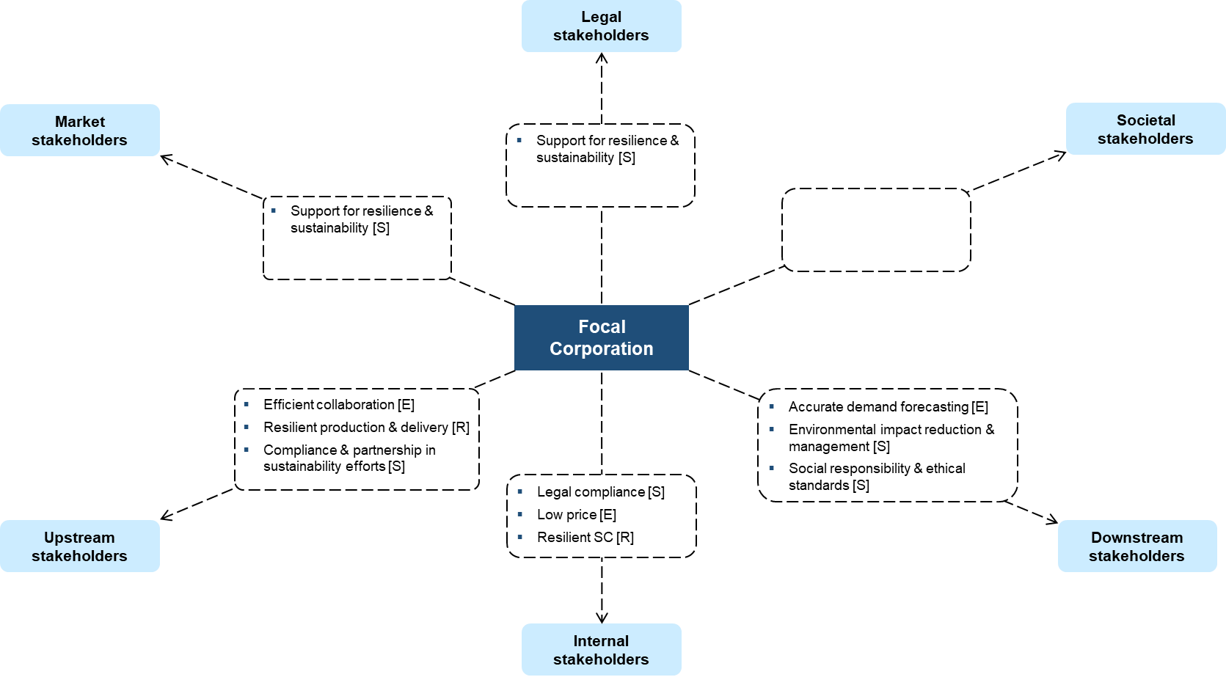
Higher-level Requirements of the Focal Company for its Stakeholders
Introduction into Stakeholder Requirements

Slide 60
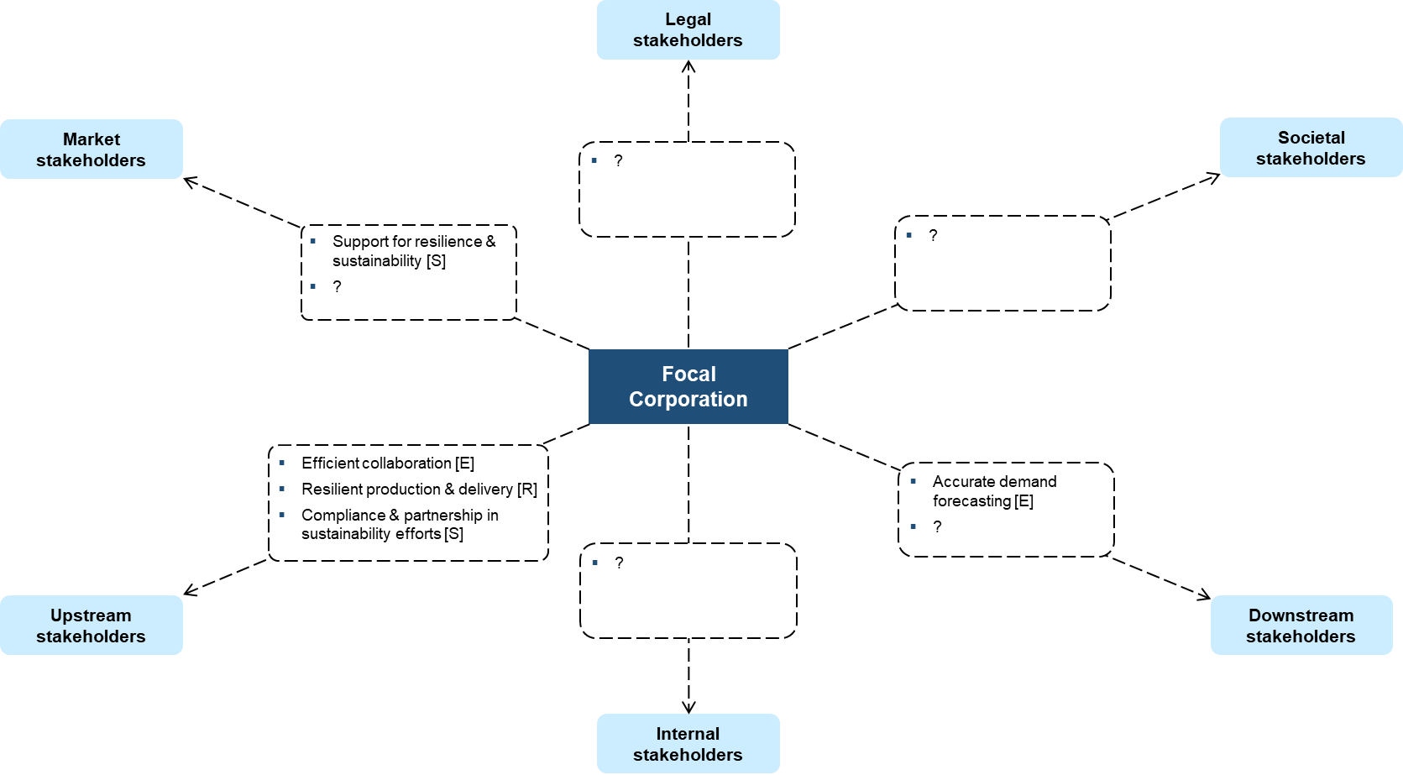
The Requirements of the Focal Company for the Upstream Stakeholders
Introduction into Stakeholder Requirements
Efficiency Requirements [E]
Resilience Requirements [R]
Efficient collaboration: Upstream stakeholders should deliver on time and reliably, maintain consistent product quality, and collaborate closely with the focal company to reduce costs and promote innovation.
Resilient production and delivery: Upstream stakeholders should demonstrate flexible production capabilities to adapt to changing demand. Additionally, they should ensure continued production and delivery even during disruptive events.
Sustainability Requirements [S]
Compliance and partnership in sustainability efforts: Upstream stakeholders must comply with legal standards, implement sustainability policies, seek partnerships with green organizations, and support second-tier supplier sustainability evaluations.

Slide 61
The Requirements of the Focal Company for the Downstream Stakeholders
Introduction into Stakeholder Requirements
Efficiency Requirements [E]
Resilience Requirements [R]
Accurate demand forecasting: The focal company expects retailers, wholesalers, and distributors to provide accurate, predictable, and constant demand forecasts. Additionally, it requires them to minimize backorder situations.
Sustainability Requirements [S]

Slide 62
The Requirements of the Focal Company for the Market Stakeholders
Introduction into Stakeholder Requirements
Resilience Requirements [R]
Efficiency Requirements [E]
Sustainability Requirements [S]
Compliance and partnership in sustainability efforts: Upstream stakeholders must comply with legal standards, implement sustainability policies, seek partnerships with green organizations, and support second-tier supplier sustainability evaluations.

Slide 63
Chapter 3: Requirements Identification
Identification of Existing Knowledge
Introduction to Stakeholder Requirements
Key Insights Research
Data Gathering
Evaluation and Prioritization

Slide 64
Task: Identify Gaps in Stakeholder Requirements Knowledge
Gap Analyzation
Review the list of stakeholders you identified and prioritized in Chapter 2.
Check the "Relevance for you" column to determine which stakeholders you need to identify more detailed requirements for. Focus on gathering detailed requirements from those rated as "medium" relevance or higher.
It might be sufficient for the other stakeholders if you consider the general requirements we presented in the previous slides.
On the next slide, we highlight again the key stakeholders for whom gathering detailed requirement information could be beneficial.

Slide 65
Consider at least the Following Stakeholders for Detailed Requirements Gathering
Gap Analyzation
Market stakeholders
  Industry associations
  Main competitors in the market
Legal stakeholders
  Laws and regulations
  Government (incl. governmental agencies)
  Safety and health groups in your industry
Societal stakeholders
  NGOs related to your use case
  Activist groups and surrounding communities
Upstream stakeholders
  Tier 1 suppliers
Internal stakeholders
  Shareholders and investors
  Board of directors and top management
Downstream stakeholders
  End customers
  Customer organizations

Slide 66
Task: Gather Detailed Requirements from Key Stakeholders
Gap Analyzation
Collect more specific requirements from the most important stakeholders you identified earlier. This is important because our general requirements per stakeholder give a starting point, but your specific stakeholder or use case may have unique needs. Please note that this might require significant effort.
Research activities may include:
  Conducting surveys with Tier-1 suppliers
  Gathering feedback from customers or end-users
  Reviewing laws in countries where you operate
  Interviewing your Board of Directors or Shareholders
  Researching important NGOs relevant to your use case
The next slide suggests approaches to help you identify these requirements. Feel free to use the templates provided in Chapter 3, including a general survey and interview questionnaire.

Slide 67
Methods for Upstream and Downstream Stakeholders
Data Gathering
Conduct surveys, questionnaires, and interviews
  Efficiently collect standardized information from a large supplier group and gain deeper insights into their challenges and requirements.
  Conduct one-on-one interviews with key suppliers or key customers. Focus on understanding their production processes, innovation capabilities, and supply chain challenges and how you might support them.
  Google Forms is a suitable tool for online surveys.
  Check our template surveys for the upstream, internal, and downstream stakeholders.
Additional approaches to gather downstream stakeholder requirements
  Gather proprietary data: Review customer surveys, suggest data collection improvements (include all dimensions, provide clear KPIs) -> Offer template.
  Engage directly on social media.
  Analyze feedback (positive & negative) and customer responses.
  Monitor online customer feedback.
  Conduct targeted customer interviews.
  Utilize social media analytics tools (e.g., Hootsuite or Brandwatch) for sentiment and theme identification.

Slide 68
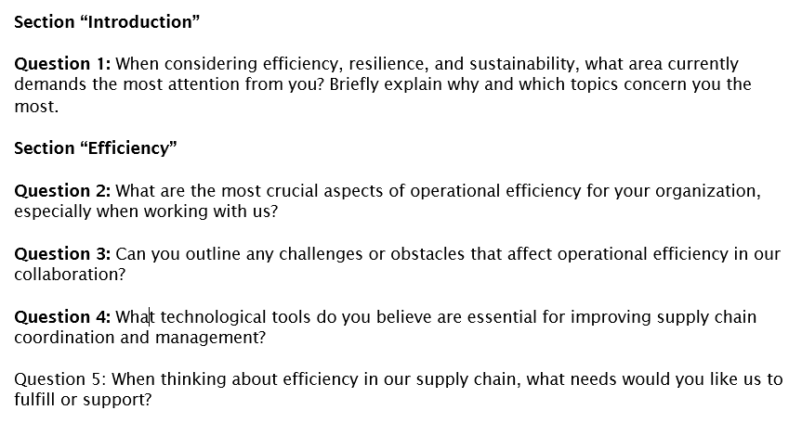
Methods for Engaging Internal Stakeholders
Data Gathering
Conduct surveys or interviews with internal stakeholders, focusing on top management, the board of directors, shareholders, and investors.
Consider organizing a brief workshop for general management to gather insights.
Feel free to use the template available in our toolkit to conduct internal stakeholder surveys.

Slide 69
Methods for Market, Legal and Societal Stakeholders
Data Gathering
Market stakeholders
  Study industry reports from studies, associations, consulting firms, and research institutions, e.g., Economiesuisse, Swissmem, scienceindustries or Swiss Cleantech.
  Conduct industry comparisons: Compare processes/performance with leading companies in your industry to identify best practices.
  Review case studies to learn from previous experiences.
Legal stakeholders
  Analyze websites and laws of governmental institutions.
  Consulting firms often provide good overviews of legal regulations, such as the EQS Group,
Societal stakeholders
  Determine the direction of key NGOs, such as WWF. Consider checking WANGO to identify the most important NGOs and their global directions.
  Study networks/platforms for activist groups and movements in the population; review journals and newspapers from the regions where you operate.

Slide 70
Chapter 3: Requirements Identification
Identification of Existing Knowledge
Introduction into Stakeholder Requirements
Key Insights
Data Gathering
Evaluation and Prioritization

Slide 71
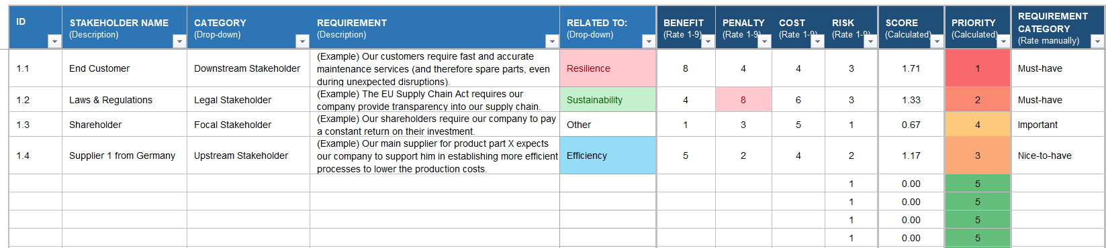
Task: Prioritizing the Identified Requirements
Evaluation and Prioritization
In this chapter, you will perform a “Relative Weighted Prioritization” of your identified requirements.
Use for this chapter the template from our template set:
All your identified requirements are listed on the left side. Using the right part of the template, you will assess and prioritize those requirements.
Follow the instructions on the next slides and perform the evaluation with your team.

Slide 72
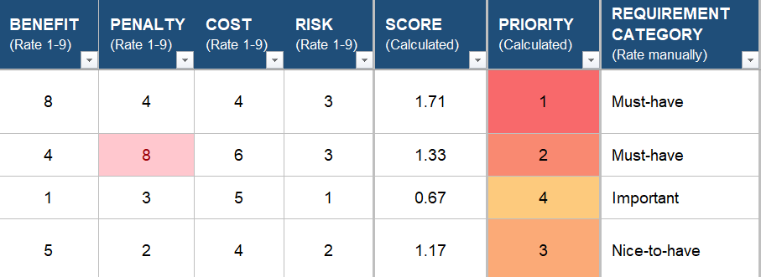
The Factors of the Relative Weighting Method
Evaluation and Prioritization
We propose a straightforward version of the “Relative Weighting Method,” where your team will assess each requirement based on the following factors with a weighted scare:
Benefit for the end customer from fulfilling this requirement. Think about a “feature”; what is the advantage for the end customer if this “feature” (= requirement) is added to the final product?
Penalty for your company for not fulfilling the requirement. What is the consequence for your company or the end customers, if this feature is not added to the final product?
Cost for your company to fulfill the requirement.
Risk incurred in fulfilling the requirement.
For each factor, assign them a value between 1 (the lowest, e.g., no benefit for the end customer) and 9 (the highest, e.g., the most severe penalty for the company).
The score and priority will be calculated automatically.

Slide 73
Score and Priority Calculation of the Relative Weighting Method
Evaluation and Prioritization
The score will be determined automatically by the template:
Score = (Benefit + Penalty) / (Cost + Risk)
The maximal value theoretically could be 9 (Benefit and Penalty = 9, Cost and Risk = 1).
Vice versa, the lowest possible value could be 0.1 (Benefit and Penalty = 1, Cost and Risk = 9).
Therefore, the values will be between 0.1 and 9 but typically between 0.5 and 3.
3, for example, indicates a higher importance, while 0.5 indicates a low importance.
If the Penalty exceeds 6, the cell will be automatically colored red.
The priority is automatically determined and represents a simple rank of the requirement. The highest value gets the rank “1,” and the lowest value gets the rank “n” (depending on the number of requirements listed).
This automated evaluation of the requirements gives you an overview of the most relevant requirements. They are not definitive. In the next step, you will decide with your team the final category of the requirement and whether you decide to fulfill it or not.

Slide 74
Assigning a Final Prioritization Category to the Requirement
Evaluation and Prioritization
At the end, we suggest that you go through each requirement again and manually assign them one of the following three categories:
Must-have requirements are essential for the company's survival and non-compliance poses existential threats.
Important requirements benefit the company significantly, but non-compliance can have severe consequences.
Nice-to-have requirements are not critical for the company, though implementing them could enhance its image.

Slide 75
Strengths and Weaknesses of the Relative Weighting Method
Evaluation and Prioritization
Advantages
Objective decision-making through qualitative judgments by the team, making the decision process more objective by using numerical weights and scores.
Transparent documentation of the prioritization through systematic scoring and weighting.
End-prioritization of the requirements still depends on the team’s intuitive decision.
Disadvantages and mitigation strategies
Certain complexity with many criteria and options to weigh and score. Ensure that the team leader understands the mechanism and gives a solid briefing about the method to the team.
Subjectivity in weight assignment; ensure that every team member can bring in their perspectives to minimize subjectivity of single persons.
Do not forget to identify and assess qualitative factors, which might be harder to assess since they are not easily quantifiable.

